Slide 1
Major Project 1st Review
Department No : 18 – PCA - 025
Student Name : S.GOPINATH
Company Name : Candid techno solution
Project Title : Dynamic concealment in recital visual blockchain

Slide 2

Company Profile
Organization details
The main focus of the Candid Techno Solution company is on developing a business model that
has a clear idea on providing a cost-effective software and application to all of the clients’ around
the world.
Services
Application development
Infrastructure Management
Web designing
Mobility Solution
Cloud Computing
P roduct Engineering services
Big Data
Business Intelligence

Slide 3
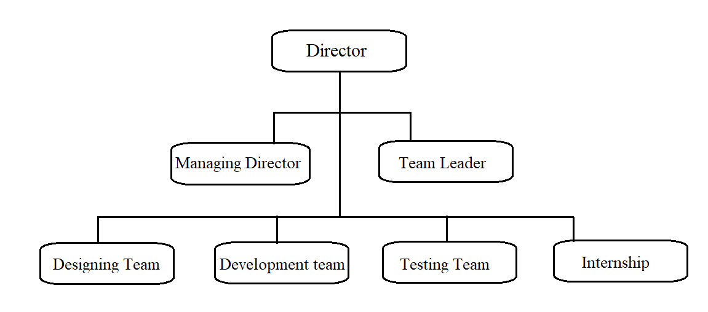
Organization Chart

Slide 4
Project details
Project Title : Dynamic concealment in recital visual block chain
Project – Banking Application using Block chain
Language - Python
Software – Anaconda & Phycharm
Type of application – Web Application

Slide 5
Description of the problem phase
Introduction
Description of the problem
Ripple – High throughput block chain with 1500 Transaction Per second .
This gives banks with official records of asset ownership as the
authenticators are legally responsible for processing transactions
honestly.
xRapid - Transaction settlements
xCurrent - swift messaging
XRP Server

Slide 6
Objective
Customers will register with the User Id and Password.
To know the status of the Account.
Know the details of the previous transaction.
Update the upcoming schedule.
Remind the customers about the information through the notification.
Provides high authentication and data security.

Slide 7
Existing System
Mobile Banking
Advantages
Accessing the bank 24/7
Optimizing your money
Strengthening security
Offering clarity of where your financial data is going
Disadvantages
frustrated with a digital banking
Navigating the apps can feel daunting
Cash gets lock at some time

Slide 8
Existing System Continue…
Reply Block chain Application
Advantages
Provide High Security
Low Fragmentation And Easy Testing
Secure Transactions
Disadvantages:
Use excessive energy
Mining does not provide network security
Entries do not last forever or are not immutable
Bank balance enquiry
Advantages:
Available 24*7
Multipurpose
Disadvantages:
Chances of Fraud
No Personal Touch

Slide 9
Other possible Solution
Secure Banking system
Advantages
Reduced Transaction Costs
Trustworthy Distributed Systems
Instant Payments at Reduced Costs
Disadvantages
It cannot do low level stuff like interfacing directly with hardware through drivers and firmware.
It doesn't come with a standalone compiler that can directly interpret the higher levels of the language.
Banking help
Advantages
Easy to access from any location.
Good support for distributed system.
Increased Stability
Disadvantages
Security issues
While the user tries to download multiple files at once there may be issues of system performance degradation.

Slide 10
OVERALL PROJECT PLAN
PHASE | NAME | DESCRIPTION | START DATE | END DATE
Phase I | Analysis | Understanding the problem, existing solution and defining the proposed Solution | 19.01.2021 | 23-02-2021
Phase II | Design | Designing the project | 24-02-2021 | 02-03-2021
Phase III | Implementation | Coding and Implementing | 03-03-2021 | 19-03-2021
Phase IV | Testing | Testing the system | 21-03-2021 | 30-03-2021
Phase V | Documentation | Preparing the document | 01-04-2021 | 05-04-2021

Slide 11
THANK YOU

